Slide 1
Application Gateway
[Delivery CSA Name]

Slide 3
App Gateway Fundamentals

Slide 4




Load Balancing Portfolio
Standard Load Balancer
VM/VMSS/AKS workloads
L4 passthrough LB
Regional/Global
Application Gateway
VM/VMSS/Hybrid workloads
L7 regional LB
TCP/TLS proxy
WAF
Front Door
VM/VMSS/Hybrid workloads
L7 global LB
TCP/TLS proxy
WAF
Application Gateway for Containers
AKS/container workloads
Dynamic traffic shifting
L7 Ingress Controller
Regional/Global
WAF
Notes:
Azure load balancing portfolio
Azure Load Balancing: For layer 4 load balancing -> TCP or UDP traffic
As you move up the OSI model you move to layer 7
Application Load balancing provides more features like session affinity or TLS offloading. More feature functionality
App gateway : regional
Azure front door : global work loads

Slide 5
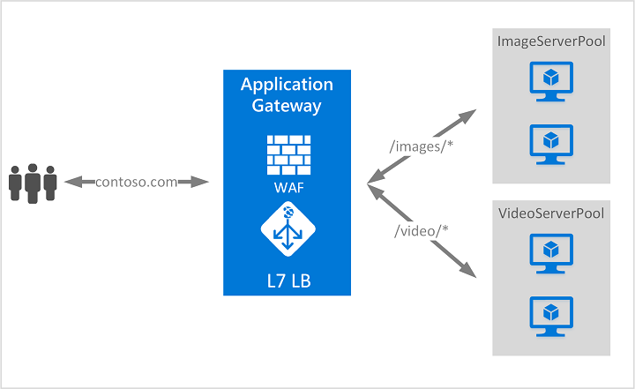
What is App Gateway
Web traffic load balancer
Manage traffic to web apps
Intelligent routing
HTTP Requests
  URL paths
  Host headers
Notes:
Azure Application Gateway is a web traffic load balancer that helps you manage traffic to your web applications.
Unlike traditional load balancers that route traffic based on IP address and port, Application Gateway makes intelligent routing decisions based on HTTP request attributes like URL paths and host headers.
For example, you can route requests with /images in the URL to servers optimized for images, while routing /video requests to servers optimized for video content. This application layer routing gives you more control over how traffic flows to your applications.
Application load balancer for AKS workloads

Slide 6
What is App Gateway
Operates at application layer (OSI layer 7)
Provides features like SSL/TLS termination, autoscaling, zone redundancy and integration with Web Application Firewall for security
Notes:
Application Gateway operates at the application layer (OSI layer 7) and provides features like SSL/TLS termination, autoscaling, zone redundancy, and integration with Web Application Firewall for security.

Slide 7
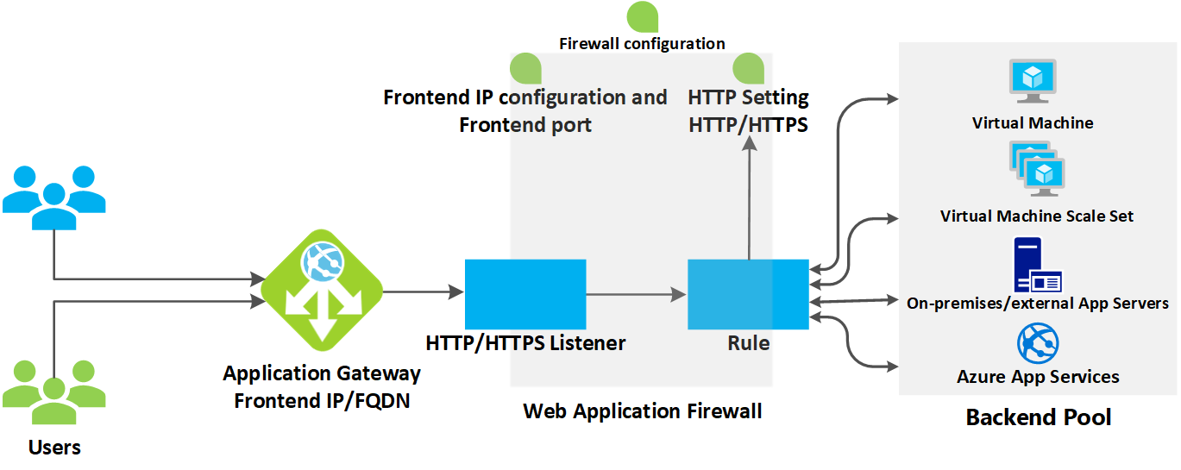
How does App Gateway work
Before client sends request, it resolves domain name of app gateway using Domain Name System (DNS) server
Azure DNS returns IP address to client
App gateway accepts incoming traffic on 1 or more listeners
If Web Application Firewall is in use, app gateway checks request headers and body.
Notes:
Before a client sends a request to an application gateway, it resolves the domain name of the application gateway by using a Domain Name System (DNS) server. Azure controls the DNS entry because all application gateways are in the azure.com domain.
The Azure DNS returns the IP address to the client, which is the frontend IP address of the application gateway.
The application gateway accepts incoming traffic on one or more listeners. A listener is a logical entity that checks for connection requests. It's configured with a frontend IP address, protocol, and port number for connections from clients to the application gateway.
If a web application firewall (WAF) is in use, the application gateway checks the request headers and the body, if present, against WAF rules. This action determines if the request is valid request or a security threat. If the request is valid, it's routed to the backend. If the request isn't valid and WAF is in Prevention mode, it's blocked as a security threat. If it's in Detection mode, the request is evaluated and logged, but still forwarded to the backend server.
Azure Application Gateway can be used as an internal application load balancer or as an internet-facing application load balancer. An internet-facing application gateway uses public IP addresses. The DNS name of an internet-facing application gateway is publicly resolvable to its public IP address. As a result, internet-facing application gateways can route client requests from the internet.
Internal application gateways use only private IP addresses. If you're using a Custom or Private DNS zone, the domain name should be internally resolvable to the private IP address of the Application Gateway. Therefore, internal load-balancers can only route requests from clients with access to a virtual network for the application gateway.

Slide 8
App Gateway Security

Slide 9
Secure your Application Gateway
App gateway is a web traffic load balancer that enables you to manage traffic to your web applications
Handles incoming requests and routes them to backend services
Components needed to best secure your App Gateway deployments:
  Network Security
  Web Application Protection
  Identity and access management
  Data protection
  Monitoring and threat detection
  Asset management
Notes:
Azure Application Gateway is a web traffic load balancer that enables you to manage traffic to your web applications. As a critical component in your network infrastructure, Application Gateway handles incoming requests and routes them to backend services, making it essential to implement proper security measures to protect against threats and ensure compliance with organizational security requirements.

Slide 10
Network Security
Deploy into a dedicated subnet for isolation and traffic control.
Apply Network Security Groups (NSGs) to restrict ports, protocols, and IPs.
Use Private Endpoints to remove public exposure and keep traffic internal.
Enable Azure DDoS Network Protection for large‑scale attack mitigation.
Follow recommended infrastructure configuration (subnets, routing, dependencies).
Notes:
Network Security Overview
Network security for Application Gateway is all about controlling traffic flow, segmenting your network, and ensuring secure communication between clients and backend systems. This reduces the attack surface and improves resilience.
1. Deploy into a Dedicated Subnet
Application Gateway should always sit in its own dedicated subnet.
This provides network isolation, supports granular security policies, and prevents cross‑service blast radius.
It also aligns with Azure’s required infrastructure model for App Gateway.
2. Apply Network Security Groups (NSGs)
NSGs allow you to restrict inbound/outbound traffic by port, protocol, and IP ranges.
Only open the ports required for gateway operation; block management ports from untrusted networks.
This adds a strong first layer of perimeter control for the subnet.
3. Use Private Endpoints (Private Link)
Private endpoints remove public internet exposure entirely and funnel traffic through your VNet.
This significantly reduces the attack surface and ensures fully private east‑west access to backend pools.
4. Enable Azure DDoS Network Protection
Adding DDoS Network Protection to the hosting VNet provides:
Adaptive tuning
Always‑on traffic monitoring
Attack notification
This protects the Application Gateway against volumetric and protocol‑based DDoS attacks.
5. Follow Azure’s Infrastructure Best Practices
Ensure correct subnet sizing, route tables, and dependency planning.
Azure Virtual Network Manager can help apply network policies at scale.
Proper configuration ensures reliability and security as traffic grows.

Slide 11
Web Application Protection
Deploy WAF to protect against OWASP Top 10 (SQLi, XSS, common web attacks). Start in Detection, then move to Prevention.
Custom WAF rules for rate limiting, IP blocking, and geo‑filtering.
Enable bot protection to block malicious bots and allow legitimate crawlers.
Implement rate limiting to prevent abuse and mitigate DDoS patterns.
Notes:
Web Application Protection Overview
Azure Web Application Firewall (WAF) provides critical Layer‑7 protection for any app fronted by Application Gateway. It helps block common web vulnerabilities and automated attack patterns before they ever reach your backend.
1. Deploy Web Application Firewall
Enabling WAF adds baked‑in protection against OWASP Top 10 threats, including SQL injection, cross‑site scripting, and protocol violations.
Begin in Detection mode to observe baseline traffic and identify false positives.
Move to Prevention mode once tuning is complete to actively block malicious traffic.
WAF integrates with Azure Monitor and Defender for Cloud for visibility and security posture management.
2. Configure Custom WAF Rules
Custom rules help you protect against application‑specific threats beyond the managed rule sets.
Common use cases include rate limiting, blocking specific IP ranges, or geo‑filtering based on region.
Customization helps reduce false positives and ensure policies map tightly to your application logic.
3. Enable Bot Protection
The bot protection managed rule set uses IP reputation data to distinguish between good and bad bots.
This helps block credential stuffing, scraping, and scanning tools while still allowing search engine crawlers and monitoring services.
4. Implement Rate Limiting
Rate limiting rules allow you to throttle requests from individual IPs within defined time windows.
This protects your app from abuse patterns, reduces the impact of automated attacks, and limits the early stages of DDoS attempts at Layer 7.

Slide 12
Identity and Access Management
Configure mutual authentication (mTLS) to authenticate both client and gateway.
Use Azure RBAC to restrict who can modify Application Gateway resources. Apply least‑privilege access.
Notes:
Identity & Access Management Overview
Identity and access controls ensure that only authorized users and systems can interact with Application Gateway or change its configuration. Strong IAM reduces unauthorized access risk and supports compliance.
1. Configure Mutual Authentication (mTLS)
Mutual TLS provides two-way authentication where both the client proves its identity and the gateway validates it.
This is ideal for sensitive or regulated workloads, internal APIs, partner integrations, and scenarios where client identity must be strongly verified.
Mutual authentication is certificate-based: upload trusted client CA certificates to the gateway to validate incoming clients.
Recommended to use TLS 1.2, as it will be the mandated version.
This significantly strengthens your security posture by ensuring only trusted clients can connect.
2. Use Azure RBAC for Management Access
Azure RBAC (Role-Based Access Control) allows you to strictly control who can modify Application Gateway configuration.
Assign minimum necessary permissions to users, groups, and service principals.
RBAC scopes can be applied at management group, subscription, resource group, or resource level, letting you tightly scope administrative rights.
This supports least privilege, helps avoid misconfigurations, and protects critical networking components from accidental or unauthorized change

Slide 13
Data Protection
Enable TLS encryption (TLS termination + latest TLS versions).
Store certificates in Azure Key Vault for secure storage + automatic rotation.
Secure certificate management with automated renewal + strong key standards.
HTTP → HTTPS redirection to ensure encrypted traffic.
Configure end‑to‑end TLS for full-path encryption to backend servers.
Notes:
Data Protection Overview
Data protection in Application Gateway focuses on securing all data in transit and managing certificates and secrets correctly. This includes TLS usage, automated certificate lifecycle management, and ensuring all communication paths are encrypted.
1. Enable TLS Encryption
Configure TLS termination at the Application Gateway to encrypt client → gateway traffic.
Always use the latest supported TLS versions (TLS 1.2+).
This protects against known vulnerabilities and improves security posture.
2. Store Certificates in Azure Key Vault
Move TLS certificates out of config files and into Azure Key Vault, which provides:
Secure secret storage
Access control
Centralized certificate lifecycle management
Key Vault also enables automatic certificate rotation when integrated with Application Gateway.
3. Configure Secure Certificate Management
Automate certificate rotation to avoid certificate expiry risks.
Ensure certificates follow security standards:
Sufficient key sizes
Appropriate validity periods
Following organizational governance
This ensures Gateway configurations remain compliant and secure.
4. Implement HTTP → HTTPS Redirection
Forces all inbound traffic to use encrypted channels.
Prevents sensitive data from being transmitted in plaintext.
Essential for compliance and secure-by-default posture.
5. Configure End‑to‑End TLS
Encrypt traffic not only between client → gateway but also gateway → backend servers.
Ensures full path confidentiality and integrity in regulated or highly sensitive environments.
Requires backend server certificates to be trusted by the gateway.

Slide 14
Monitoring and Threat Detection
Enable diagnostic logging for detailed operational and security insights.
Configure custom health probes for deeper backend visibility.
Set up monitoring & alerting with Azure Monitor.
Centralize log management using SIEM integration.
Monitor backend health continuously for availability & security issues.
Notes:
Monitoring & Threat Detection Overview
Monitoring and threat detection help ensure the Application Gateway is healthy, secure, and functioning as expected. Logging, probes, and alerting provide real‑time visibility into performance and potential threats.
1. Enable Diagnostic Logging
Turn on Azure resource logs to capture detailed information about:
Access patterns
Performance metrics
Security events
Send logs to Log Analytics, Storage Accounts, or Event Hub to support analysis, reporting, and long‑term retention.
This visibility is essential for detecting anomalies and understanding gateway behavior over time.
2. Configure Custom Health Probes
Default probes only detect basic connectivity issues.
Custom probes allow deeper inspection such as:
Application‑level health
Specific path checks
Authentication or header requirements
Ensures traffic is routed only to healthy and responsive backend instances.
3. Set Up Monitoring and Alerting
Use Azure Monitor to track key metrics:
Unusual traffic patterns
Repeated failed requests
Latency or throughput changes
Create alerts to detect issues early — often the first signal of security threats or misconfigurations.
4. Implement Centralized Log Management
Forward logs to your organization’s SIEM solution (e.g., Microsoft Sentinel).
This enables:
Correlation of events across your environment
Automated incident response
Threat detection based on global attack patterns
5. Monitor Backend Health
Use the built‑in Backend Health feature to continuously track the status of backend servers.
Quickly identify:
Unhealthy instances
Misconfigurations
Latency or networking issues
Helps prevent outages and reduces the risk of exposing unhealthy nodes.

Slide 15
Asset Management
Implement Azure Policy governance to audit & enforce secure configurations.
Monitor configuration compliance using Microsoft Defender for Cloud alerts & baselines.
Notes:
Asset Management Overview
Asset management ensures your Application Gateway remains secure, compliant, and properly configured at all times. It introduces governance controls and continuous compliance checks to align with organizational and industry standards.
1. Implement Azure Policy Governance
Use Azure Policy to apply guardrails across all Application Gateway deployments.
Policies can:
Audit configurations
Enforce required settings
Prevent insecure deployments
This ensures standardized, compliant configurations across environments.
(Additional depth: Azure Policy provides real-time governance, centralized compliance dashboards, and automated remediation at scale.)
2. Monitor Configuration Compliance
Use Microsoft Defender for Cloud to track Application Gateway compliance against security baselines.
Defender alerts you when:
Configurations drift
Security standards are violated
Non-compliant settings appear across gateways
Enable automated remediation where possible to maintain consistent security posture and reduce operational overhead.

Slide 16
App Gateway for Containers

Slide 17
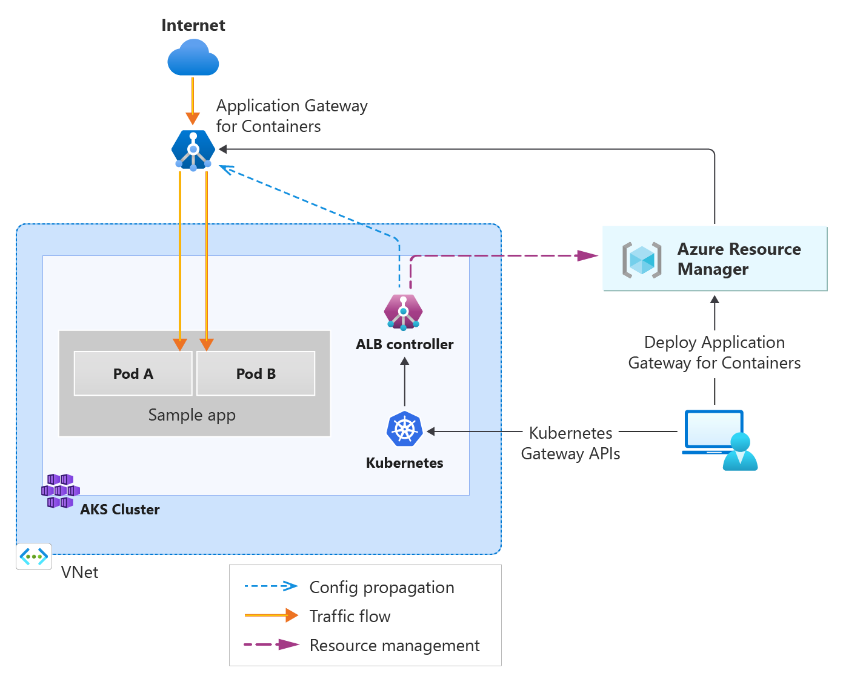
App Gateway for Containers
Microsoft Managed solution
Integrates to Azure control plane
Scale
Mutual authentication
Weighted load distribution

Slide 18
What is App Gateway for Containers
L7 load balancing + dynamic traffic management for Kubernetes workloads.
Part of the Application Gateway product family; extends Azure Load Balancing.
Evolution of the Application Gateway Ingress Controller (AGIC).
AGIC monitored Kubernetes resources and applied config via ARM.
Notes:
Overview
Application Gateway for Containers is Azure’s next‑generation, application-layer (Layer 7) load balancer built specifically for Kubernetes workloads. It provides dynamic traffic management, integrating natively into container-based architectures and extending Azure’s load balancing portfolio.
1. Purpose & Capabilities
Designed for Kubernetes clusters, delivering L7 load balancing similar to Application Gateway but optimized for containerized apps.
Supports dynamic traffic management, enabling fast updates as pods, routes, or probes change.
Offers higher performance and flexibility than previous solutions.
2. Evolution of AGIC (Application Gateway Ingress Controller)
AGIC was the earlier Kubernetes integration layer that synced Kubernetes Ingress resources into Application Gateway using ARM.
In its current form, AGIC monitored a subset of Kubernetes resources and applied changes to the Application Gateway control plane.
Application Gateway for Containers improves on AGIC by addressing performance and scalability gaps, especially around the rapid lifecycle of Kubernetes pods.
3. Application Gateway for Containers as the Successor
Represents the future direction of Azure’s ingress strategy for AKS.
Built for modern Kubernetes patterns, supporting both Ingress and Gateway API.
Integrates with new control-plane components (ALB Controller) and offers near real‑time updates.

Slide 19
How does it work
Application Gateway for Containers is made up of three components:
  Application Gateway for Containers resource
  Frontends
  Associations
The following dependencies are also referenced in an Application Gateway for Containers deployment:
  Private IP address
  Subnet Delegation
  User-assigned Managed Identity
Notes:
Application Gateway for Containers is built from three core components, each playing a different role in how traffic is processed and managed.
1. Application Gateway for Containers Resource
This is the primary resource that represents the gateway itself. Builds the control plane to listen for changes coming from the ALB controller
It acts as the ingress point for applications running inside your Kubernetes cluster.
All configuration, routing logic, and policy enforcement flow through this central component.
2. Frontends
Frontends define how traffic enters the gateway. Similar to Azure frontdoor
They typically include the IP addresses, ports, and protocols exposed externally or internally.
When a request hits the gateway, the frontend is what receives it and hands it off to the right routing rules.
3. Associations
Associations provide the link between the gateway and the Kubernetes environment.
They map Kubernetes Gateway API or Ingress configurations to the corresponding Azure resources.
Think of these as the “glue” connecting your cluster definitions to the Application Gateway for Containers.
In addition to the core components, several Azure dependencies must be in place for a successful deployment.
Key Dependencies
Private IP Address
The gateway needs a private IP for internal routing to services in your AKS cluster.
This ensures secure and controlled east‑west traffic.
Subnet Delegation
The Application Gateway for Containers runs in a delegated subnet.
Subnet delegation grants Azure the permissions it needs to manage the gateway’s lifecycle and networking.
User‑Assigned Managed Identity
A user‑assigned managed identity provides secure, policy‑driven access for the gateway to interact with Azure resources.
This identity is used for tasks like pulling Key Vault certificates or modifying configuration via ARM.
Together, these components and dependencies form the foundation of Application Gateway for Containers, giving you a scalable, Kubernetes‑native ingress solution that integrates deeply with Azure networking and security.

Slide 20
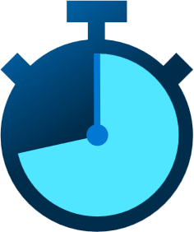




Application Gateway for Containers (AGC)
Managed Application Load Balancer
for Kubernetes
Near real-time configuration updates
External to cluster – offload network compute
Deploy via ARM, Bicep, PowerShell, CLI, Terraform, Gateway API, and Ingress API
TLS offloading and Backend Mutual Authentication
Manage resource lifecycle via Kubernetes or Azure
URL / Header Rewrite and Routing
Monitor & Troubleshoot via Azure Monitor, Prometheus, local backend health, and resource status
Weigh traffic for blue/green deployments
Notes:
How AGC Fits Into the Architecture
“Starting on the left, we have the Application Gateway for Containers sitting outside the AKS cluster.”
It receives all inbound traffic from the internet and acts as the main entry point for containerized workloads.
“Inside the AKS cluster, you’ll notice the ALB controller.”
This controller monitors Kubernetes Gateway API or Ingress resources and keeps AGC’s configuration synced in near real‑time. This gives us cloud‑native, Kubernetes‑driven control over how traffic is routed.
“Azure Resource Manager sits on the right side of the diagram.”
Any configuration changes whether initiated by Kubernetes or Azure tooling are propagated through ARM, which orchestrates the lifecycle of the AGC resources.
“The key benefit here is that AGC offloads network compute from the cluster.”
It removes networking overhead from the worker nodes and provides a highly scalable, Azure‑managed ingress layer.
Key Capabilities Highlighted on the Slide
Near real‑time updates: AGC reacts extremely quickly to pod scaling events, new routes, or configuration changes, making it ideal for dynamic microservice environments.
External to cluster / offload network compute: Since AGC runs outside AKS, it reduces network processing overhead on your nodes and improves overall cluster efficiency.
Flexible deployment: You can deploy and manage AGC using ARM, Bicep, PowerShell, CLI, Terraform, Gateway API, or Ingress API, whichever fits your operational model.
TLS offloading + Backend mutual authentication: AGC handles TLS termination and also supports mTLS to backend services, enhancing security and reducing certificate overhead inside the cluster.
Lifecycle management via Kubernetes or Azure: You can choose a “Kubernetes‑native” model managed by the ALB controller or a “bring your own” Azure‑managed model, offering flexibility depending on your team structure.
URL/Header rewrite and routing: Advanced traffic transformation capabilities allow you to shape requests before they reach your services.
Monitoring & troubleshooting: AGC integrates with Azure Monitor, Prometheus, and local backend health checks, giving full visibility into traffic flows and service status.
Weighted traffic for blue/green deployments: You can gradually shift traffic between versions using weighted routing, enabling safe rollouts and controlled testing.
“Overall, Application Gateway for Containers gives Kubernetes users a powerful, Azure‑native ingress solution with modern traffic management, real‑time updates, strong security features, and deep operational visibility, all without adding complexity to the cluster itself.”

Slide 21
Architecture of Application Gateway for Containers
Internet traffic enters via Application Gateway for Containers
AKS Pods receive routed L7 traffic (Pod A / Pod B)
ALB Controller syncs Kubernetes Gateway API → Azure Resource Manager
ARM stores and updates configuration
Config Propagation (K8s → Controller → ARM → Gateway)
Traffic Flow (Gateway → Pods)
Notes:
Here’s how Application Gateway for Containers integrates with AKS.
External traffic arrives through the Application Gateway for Containers, which performs Layer 7 routing before sending traffic into the AKS cluster to the backend pods — in this example, Pod A and Pod B.
Inside the cluster, the ALB controller watches Kubernetes Gateway API resources and translates those definitions into the configuration used by the Application Gateway. It sends that configuration to Azure Resource Manager, which becomes the authoritative store for the gateway’s runtime state.
Once ARM applies the updated configuration, the Application Gateway is ready to route traffic based on the Kubernetes declarations.
So the overall flow is: Kubernetes defines routing → ALB controller syncs it → ARM updates the gateway → the gateway routes traffic into the cluster. This gives you a fully managed, Kubernetes‑native ingress experience with Azure-native L7 capabilities

Slide 22
Application Gateway for Containers
Components of AGC
Azure Resource Manager
AGC
Frontend
Association
Kubernetes
ALB Controller
ApplicationLoadBalancer CR
Notes:
Components of AGC
Azure Resource Manager (ARM)
“ARM is the control plane for AGC.”
It handles provisioning, updating, and maintaining all AGC‑related resources.
Any configuration that the Kubernetes controller pushes is ultimately applied through ARM.
Application Gateway for Containers (AGC)
“This is the actual gateway resource that sits outside the cluster.”
It receives traffic from the internet, applies routing rules, offloads TLS, and sends traffic into the AKS environment.
Its configuration is dynamically updated from Kubernetes via the ALB controller.
Frontend
“Frontends define how traffic enters AGC.”
They represent IP addresses, ports, and protocol listeners.
Each Kubernetes Gateway or Ingress definition relies on a corresponding frontend to expose services.
Association
“Associations act as the link between Kubernetes and Azure resources.”
They tie Frontends to the Application Gateway for Containers and ensure the gateway knows which configuration belongs to which workloads.
Kubernetes Components
ALB Controller
“Inside the AKS cluster, the ALB controller continuously monitors Kubernetes Gateway API or ApplicationLoadBalancer custom resources.”
It translates these Kubernetes resources into AGC configuration and pushes updates to ARM.
This is what enables near real‑time synchronization between Kubernetes intent and Azure infrastructure.
ApplicationLoadBalancer (CR)
“This is the Kubernetes custom resource that represents an AGC instance inside the cluster.”
When defined, it signals the ALB controller to create or update the corresponding AGC resource in Azure.
The lifecycle of this CR directly drives the lifecycle of AGC in managed deployments.
Closing Summary
“Together, these Azure and Kubernetes components create a tight integration where Kubernetes defines the desired state, the ALB controller interprets it, and ARM provisions the gatewayresulting in a fully managed, scalable, cloud‑native ingress solution for AKS

Slide 23
Features & Benefits
Traffic splitting / Weighted round‑robin
Mutual authentication to backend targets
Supports Kubernetes Ingress & Gateway API
Flexible deployment models (BYO or ALB‑managed)
Near real‑time updates for pods, routes, probes
Elastic, scalable ingress with new data & control plane, using new ARM APIs
Outside AKS data plane, ingress managed by ALB controller inside cluster
Notes:
Application Gateway for Containers introduces a modern, high‑performance ingress layer purpose‑built for Kubernetes at scale. It significantly enhances traffic control, performance, and operational flexibility compared to the legacy AGIC model.
1. Traffic Splitting / Weighted Round‑Robin
Enables advanced routing scenarios by distributing traffic across backend services with weighted rules.
Useful for blue‑green deployments, canary releases, and gradual rollout strategies.
2. Mutual Authentication to Backend Targets
Supports mTLS, allowing secure, identity‑validated communication between the gateway and backend workloads.
Improves zero‑trust postures inside the cluster.
3. Kubernetes Ingress & Gateway API Support
Works with both Ingress and the newer Gateway API, aligning with modern Kubernetes networking standards.
Provides richer traffic routing, policy attachment, and improved extensibility.
4. Flexible Deployment Strategies
Can be deployed as:
Bring‑Your‑Own (managed via Azure portal/CLI/ARM/Terraform), or
ALB‑managed, where the controller handles lifecycle automatically.
Gives teams freedom over operational models.
5. Increased Performance & Near Real‑Time Updates
New data plane enables immediate updates when pods are added, removed, or replaced.
Keeps ingress configuration in sync with the rapidly changing Kubernetes environment.
6. Elastic, Scalable Ingress with New Data & Control Plane
Built with a completely new data plane and new ARM APIs, distinct from classic Application Gateway.
Designed to scale with high‑churn container workloads (unlike AGIC, which used ARM updates less efficiently).
7. Architecture: Outside AKS Data Plane + ALB Controller
The Application Gateway for Containers runs outside the AKS data plane.
The ALB controller, running inside the cluster, manages configuration by watching Kubernetes Gateway API resources.
Ensures Kubernetes‑native control with Azure‑managed ingress capacity.
For more features visit What is Application Gateway for Containers? | Microsoft Learn

Slide 24
Deployment Strategies
Bring‑Your‑Own (BYO): You manage lifecycle of AGFC + sub‑resources via Azure Portal/CLI/ARM/Terraform.
Gateway API (BYO model): Frontend must be provisioned in Azure first; deletion is manual.
Managed by ALB Controller: ALB manages lifecycle of AGFC + sub‑resources based on Kubernetes custom resources.
Gateway API (ALB‑managed): ALB provisions & manages Frontend resources automatically.
Notes:
Overview
Application Gateway for Containers supports two primary deployment models. The choice depends on how much control your platform team wants versus how much automation and Kubernetes‑native behaviour you prefer.
1. Bring‑Your‑Own (BYO) Deployment
In this model, you own and operate the lifecycle of all Application Gateway for Containers resources:
Application Gateway for Containers resource
Association resource
Frontend resource
Provisioning is done using Azure Portal, CLI, PowerShell, Terraform, etc., then referenced within your Kubernetes manifests.
Gateway API considerations:
When creating a new Gateway object in Kubernetes, you must pre‑provision a Frontend resource in Azure.
Deleting the Gateway object in Kubernetes does not delete the Azure Frontend resource — Azure administrators must remove it manually.
2. Managed by ALB Controller Deployment
The ALB Controller, running inside the AKS cluster, fully manages lifecycle of:
Application Gateway for Containers
Association & Frontend resources
A new Application Gateway for Containers instance is automatically created whenever an ApplicationLoadBalancer custom resource is defined.
Lifecycle of AGFC resources maps directly to the lifecycle of the Kubernetes custom resource — making it cloud‑native and hands‑off.
Gateway API considerations:
When a Gateway references the ApplicationLoadBalancer resource, the ALB Controller auto‑provisions a Frontend.
Cleanup and updates also follow Gateway resource lifecycle automatically.

Slide 25
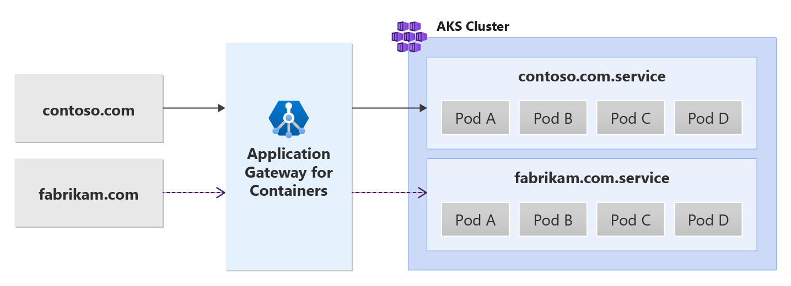
Multi-Site Hosting
Support 200 unique hostnames on a single AGC resource
Notes:
Multi-site hosting with Application Gateway for Containers - Gateway API | Microsoft Learn
one of the major advantages of AGC is its ability to host up to 200 unique hostnames on a single gateway resource.”
This means you can consolidate multiple websites, APIs, or customer‑facing domains through one centralized ingress layer reducing operational overhead and simplifying management.
Walkthrough of the Diagram
Left Side Multiple Domains
“Here you can see two example domains: contoso.com and fabrikam.com.”
These represent completely separate applications, tenants, or business units.
Center Application Gateway for Containers
“Both domains route into the same AGC instance.”
AGC inspects the incoming hostname and routes the request to the appropriate backend service inside AKS.
This gives you consistent security, DDoS protection, TLS offloading, and routing logic across all sites.
Right Side AKS Cluster Services
“Inside AKS, each hostname maps to its own service.”
contoso.com → contoso.com.service
fabrikam.com → fabrikam.com.service
Each service then independently scales its own pods Pod A, Pod B, Pod C, etc.based on workload demand.

Slide 26
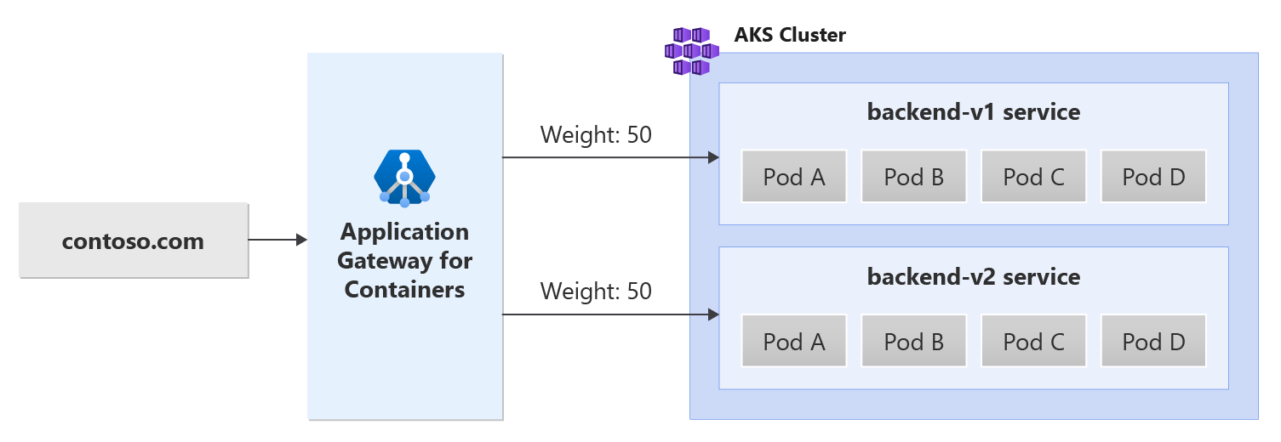
Traffic Spitting / Weighted Round Robin
Weights can be added per service
Excellent for blue/green deployments
Notes:
“Traffic splitting allows AGC to distribute incoming traffic across multiple backend services based on assigned weights.”
Instead of routing all requests to a single version of an application, you can allocate a percentage of traffic to each service.
Walk Through the Diagram
Incoming Traffic (contoso.com)
“All requests come through contoso.com and land on the Application Gateway for Containers.”
Weighted Routing
“Here, the gateway sends 50% of the traffic to the backend‑v1 service and 50% to backend‑v2.”
These weights are fully configurable — you can choose 90/10, 95/5, or any ratio that fits your deployment strategy.
Backend Services
“Each backend version runs its own set of pods. So backend‑v1 and backend‑v2 can scale independently while sharing the same entry point.”
Highlight the Use Cases
Blue/Green & Canary Deployments
“This is excellent for blue/green deployments because it lets you gradually introduce new versions.”
You can start with a small percentage of traffic routed to the new version, monitor its performance, and increase the weight over time.
Risk Reduction
“Weighted routing helps reduce deployment risk — if something goes wrong with backend‑v2, it’s easy to redirect all traffic back to the stable version instantly.”
Closing Summary
“Weighted round‑robin gives teams precise control over how traffic flows between application versions, enabling safe, incremental rollouts directly within AKS using AGC.

Slide 27
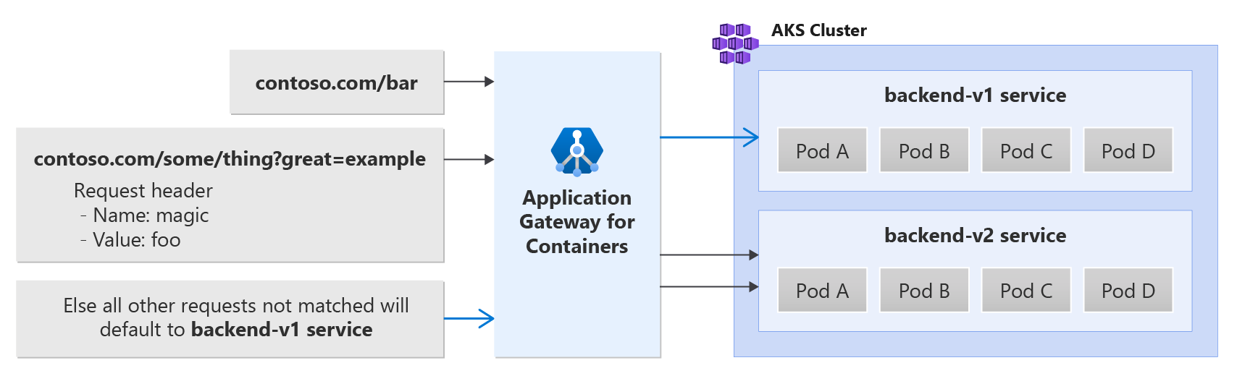
Path, Header, and Query String Routing
Route requests by path, query string and header value
Notes:
Path, header, and query string routing with Application Gateway for Containers - Gateway API | Microsoft Learn
AGC doesn’t just route based on hostnames it can make routing decisions using the request path, the query string, and even specific header values.
This is extremely useful when you have multiple versions of an API, need feature‑flag routing, or want to direct traffic to specialized microservices.
Walk Through the Examples
1. Path‑Based Routing
“The first example shows a request coming into contoso.com/bar.”
AGC recognizes the /bar path and forwards that request to the correct backend service in this case, the backend‑v1 service.
This allows clean separation of microservices by URL structure.
2. Query String & Header‑Based Routing
“The second request includes both a complex path and a query string contoso.com/some/thing?great=example along with a custom header.”
The routing rule checks:
Query parameter: great=example
Custom header: Name = magic, Value = foo
If both match, AGC routes the request to the backend‑v2 service.
This is perfect for A/B testing, partner‑specific behavior, or conditional feature rollouts.
3. Default Routing Rule
“Finally, any request that doesn’t match one of the defined rules will fall back to the default backend in this example, the backend‑v1 service.”
Defaulting ensures you always have a predictable and safe routing destination.
Why This Matters
“Fine‑grained routing allows teams to run multiple workflows, versions, or feature sets without exposing complexity to end users.”
You can use it for canary releases, device‑specific routing, API versioning, or even security filtering.
Closing Summary
“Overall, AGC gives us very powerful conditional routing capabilities. By using paths, headers, and query strings, we can ensure every request lands in the exact service that should handle it all while keeping traffic management centralized and Kubernetes‑native.”

Slide 28
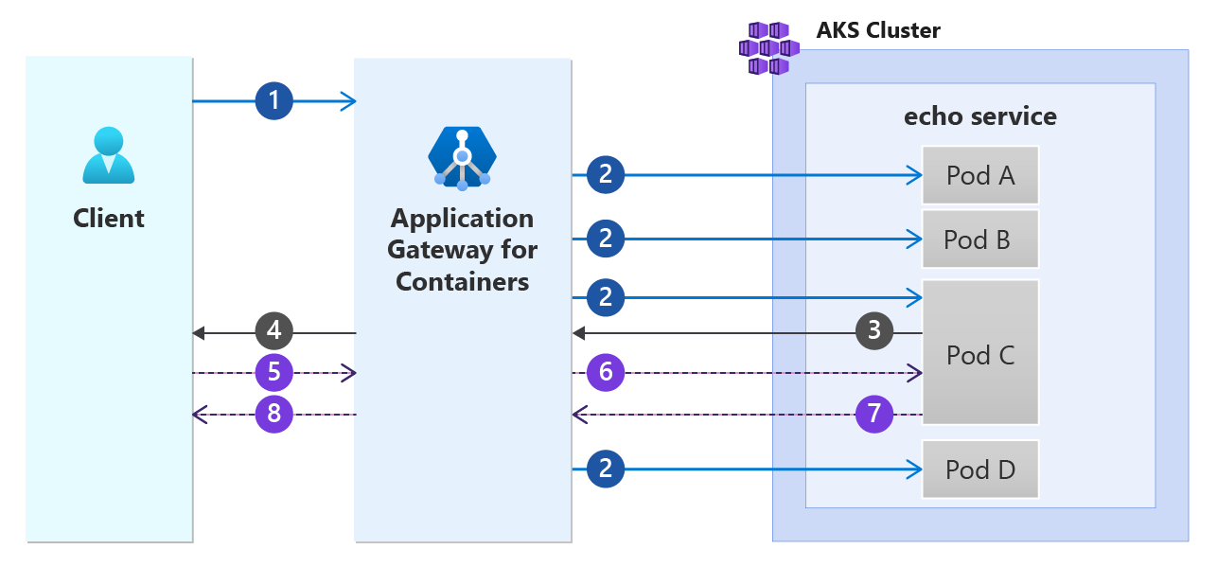
Session Affinity
Client makes a request
AGC initiates request to random pod available
Pod selected returns response
AGC returns response back to client with cookie
Client makes request to AGC with cookie
AGC sees cookie and initiates request to same pod that processed original request
Pod returns response to AGC
AGC returns response back to client
Notes:
Session affinity overview for Azure Application Gateway for Containers | Microsoft Learn

Slide 29
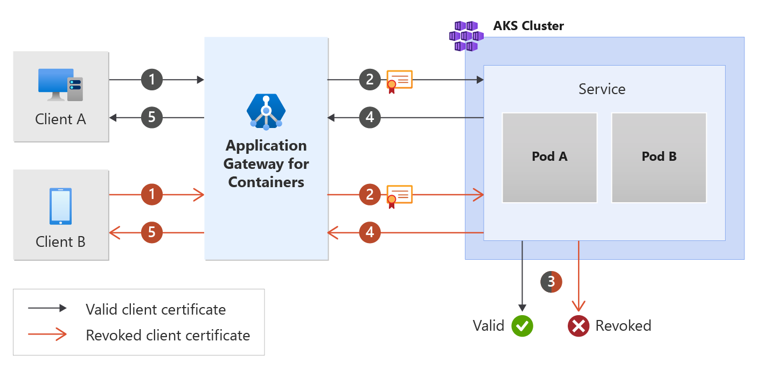
Backend Mutual Authentication
Authenticate to backend targets via client certificate
Notes:
Backend MTLS with Application Gateway for Containers - Gateway API | Microsoft Learn
Mutual Transport Layer Security (MTLS) is a process that relies on certificates to encrypt communications and identify clients to a service. This enables backend workloads to further increase its security posture by only trusting connections from authenticated devices.

Slide 30
References

Slide 31
Documentation
What is Application Gateway for Containers? | Microsoft Learn
What is Azure Application Gateway | Microsoft Learn
Azure Application Gateway features | Microsoft Learn
How an application gateway works | Microsoft Learn
Secure Your Azure Application Gateway | Microsoft Learn
Quickstart: Deploy Application Gateway for Containers ALB Controller | Microsoft Learn

Slide 32
Useful links

Slide 33
Useful Azure Kubernetes links
Public Roadmap:
Documentation:
Notes:
Email the team (internal): Azure Kubernetes Fleer Manager Leads

Slide 34
Thank you

